Slide 1
Understanding GitLab Components
An Overview of Key Concepts and Best Practices

Slide 2
What is GitLab?
GitLab is a comprehensive web application for managing the entire software development life cycle.
Key features include planning, creating, testing, securing, and deploying software.
It offers integrated tools for version control, CI/CD, issue tracking, and more.

Slide 3
GitLab Recognizes 10 Stages
Manage: Create audit and compliance reports and restrict access to resources.
Plan: Divide work into workable chunks that you can prioritize, weight, and assign to team members.
Create: Commit, review, and approve file edits, whether they contain code, configuration information, or other assets.
Verify: Run automated tests to make sure your software does what it’s supposed to.
Package: Bundle your software into a deployable format.
Secure: Find any security vulnerabilities in your software or its dependencies.
Release: Deploy your software, optionally using sophisticated techniques such as feature flags and canary deployments.
Configure: Set up the environments where your code will be deployed.
Monitor: Report on performance metrics, incidents, or errors.
Protect: Detect potential security problems in deployment environments such as Kubernetes clusters.

Slide 4
Overview of Components
Projects
Groups
Issues
Branches
Merge Requests

Slide 5
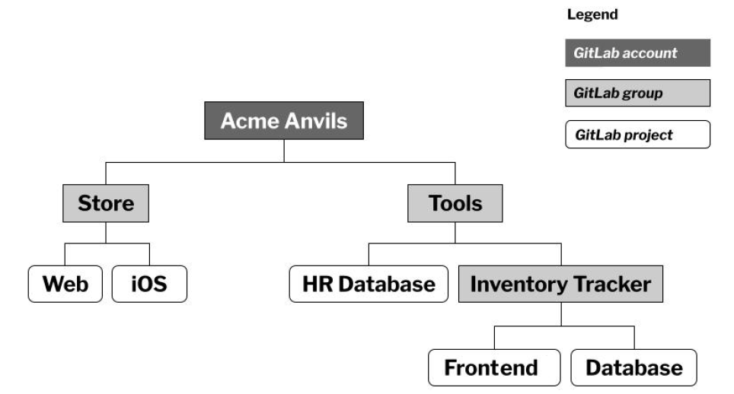
Organizing Work with Projects and Groups
Projects: Central place for your files, issues, and development activities.
Groups: Collections of related projects, which can also contain subgroups.
Examples of project and group uses.

Slide 6
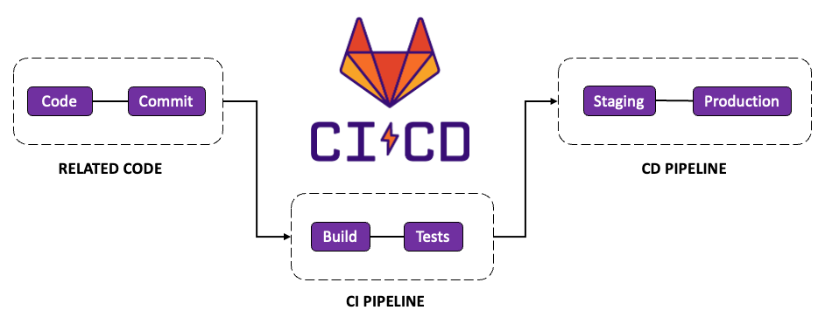
GitLab Pipeline
A GitLab CI/CD pipeline is a series of steps that are performed on your files whenever you commit edits to the GitLab-hosted copy of a repository.

Slide 7
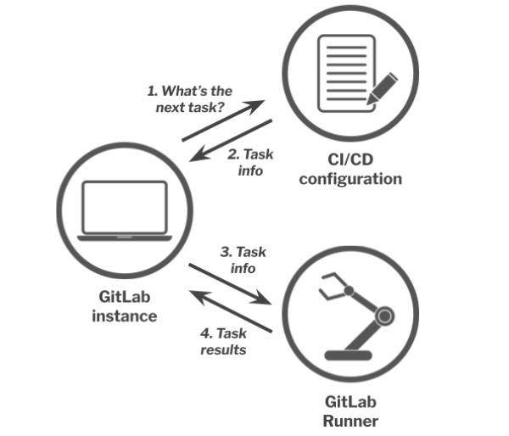
GitLab CI/CD pipeline architectural diagram

Slide 8
CI/CD Stages
Build: This stage holds tasks that compile and/or package your source code into a deployable format.
Test: This stage holds tasks that run automated tests, code quality scans and linters, and possibly security scans.
Deploy: This stage sends your code to the appropriate environment, depending on what Git branch or Git tag the pipeline is running against (among other possible factors).

Slide 9
Checking code quality in a CI/CD pipeline
Create the following folder in your project.
src/com/hatsforcats
Add a Login.java file
package com.hatsforcats;
class Login {
public static void main(String [] args) {
System.out.println("Welcome to Hats for Cats!");
}
}

Slide 10
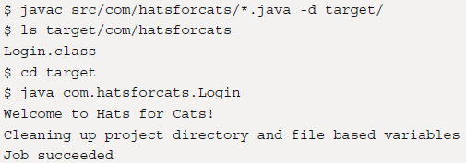
.gitlab-ci.yml
stages:
- build
compile-java-with-javac:
stage: build
image: openjdk:latest
script:
- javac src/com/hatsforcats/*.java -d target/
- ls target/com/hatsforcats
- cd target
- java com.hatsforcats.Login

Slide 11
Compiling Java with Maven
pom.xml
<project>
<modelVersion>4.0.0</modelVersion>
<groupId>org.hatsforcats</groupId>
<artifactId>login</artifactId>
<version>1.0-SNAPSHOT</version>
<properties>
<maven.compiler.source>17</maven.compiler.source>
<maven.compiler.target>17</maven.compiler.target>
</properties>
</project>

Slide 12
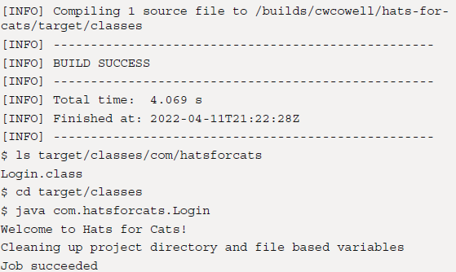
.gitlab-ci.yml
stages:
- build
compile-java-with-maven:
stage: build
image: maven:latest
script:
- mvn compile
- ls target/classes/com/hatsforcats
- cd target/classes
- java com.hatsforcats.Login

Slide 13
GitLab CI/CD Pipeline Example
# app.py
from flask import Flask
app = Flask(__name__)
@app.route("/")
def hello_world():
return "<h1>Starter Flask App</h1>"
if __name__ == '__main__':
app.run(debug=True, host='0.0.0.0', port=8080)

Slide 14
# Dockerfile
FROM python:3.11-slim
WORKDIR /srv
RUN pip install --upgrade pip
RUN pip install flask
COPY . /srv
ENV FLASK_APP=app
CMD ["python","app.py"]
# docker-compose.yaml
version: '3'
services:
web:
build: '.'
ports:
- '80:8080'

Slide 15
#.gitlab-ci.yml
variables:
DOCKER_DRIVER: overlay2
stages:
- build
- deploy
image:
name: docker:23.0.5
services:
- docker:23.0.5-dind
compile:
stage: build
script:
- echo "Build"
tags:
- ec2
- server
deploy:
stage: deploy
script:
- echo "Deploy"
- docker compose up -d --build
tags:
- ec2
- server
#.gitlab-ci.yml
variables:
DOCKER_DRIVER: overlay2
stages:
- build
- deploy
image:
name: docker:23.0.5
services:
- docker:23.0.5-dind
compile:
stage: build
script:
- echo "Build"
deploy:
stage: deploy
script:
- echo "Deploy"
- docker compose up -d --build

